Slide 1







Enterprise Blockchain Developers (Intermediate)
In support of
Powered By

Slide 2
Outline
Create a React App
© 2017-2020 SmartMesh Foundation Pte. Ltd. | MeshBox Foundation Pte. Ltd.

Slide 3
What is Node.js?
Node.js is a server-side platform built on Google Chrome's JavaScript Engine (V8 Engine).
What is a server side framework?
Web browsers communicate with web servers using the HyperText Transfer Protocol (HTTP). When you click a link on a web page, submit a form, or run a search, an HTTP request is sent from your browser to the target server.
Browers/IOS/Android
Server

Slide 4
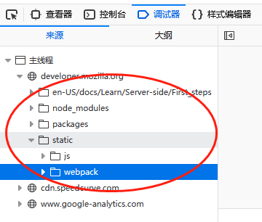
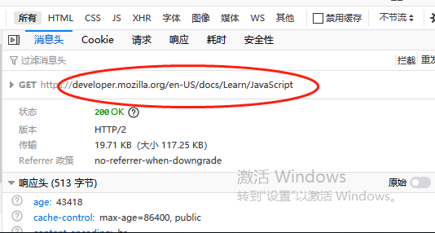
What is Node.js?
Frontend: Dowloaded in your brower
Backend/Server Side: Applications deployed in the server, handling request and data query

Slide 5
Code Demo
var http = require('http');
http.createServer(function (req, res) {
res.writeHead(200, {'Content-Type': 'text/html'});
res.end('Hello World!');
}).listen(8080);
show chrome server and brower response

Slide 6
What is Express
What is Express.js
Express is a fast, assertive, essential and moderate web framework of Node.js. You can assume express as a layer built on the top of the Node.js that helps manage a server and routes. It provides a robust set of features to develop web and mobile applications.
Let's see some of the core features of Express framework:
It can be used to design single-page, multi-page and hybrid web applications.
It allows to setup middlewares to respond to HTTP Requests.
It defines a routing table which is used to perform different actions based on HTTP method and URL.
It allows to dynamically render HTML Pages based on passing arguments to templates.

Slide 7
Code Demo
var express = require('express');
var app = express();
app.get('/', function(req, res){
res.send("Hello world!");
});
app.listen(3000);

Slide 8
MVC
The MVC pattern, in a nutshell, is this:
The model represents the data, and does nothing else. The model does NOT depend on the controller or the view.
The view displays the model data, and sends user actions (e.g. button clicks) to the controller. The view can:
be independent of both the model and the controller; or
actually be the controller, and therefore depend on the model.
The controller provides model data to the view, and interprets user actions such as button clicks. The controller depends on the view and the model. In some cases, the controller and the view are the same object.

Slide 9
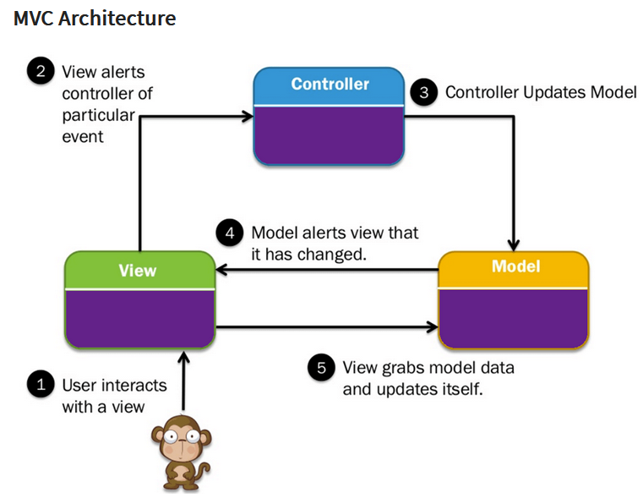
MVC

Slide 10
MVC Code Demo
https://github.com/onebit256/node-mvc-api

